Slide 1
Sliding Mode Control
2-state single-input

Slide 2
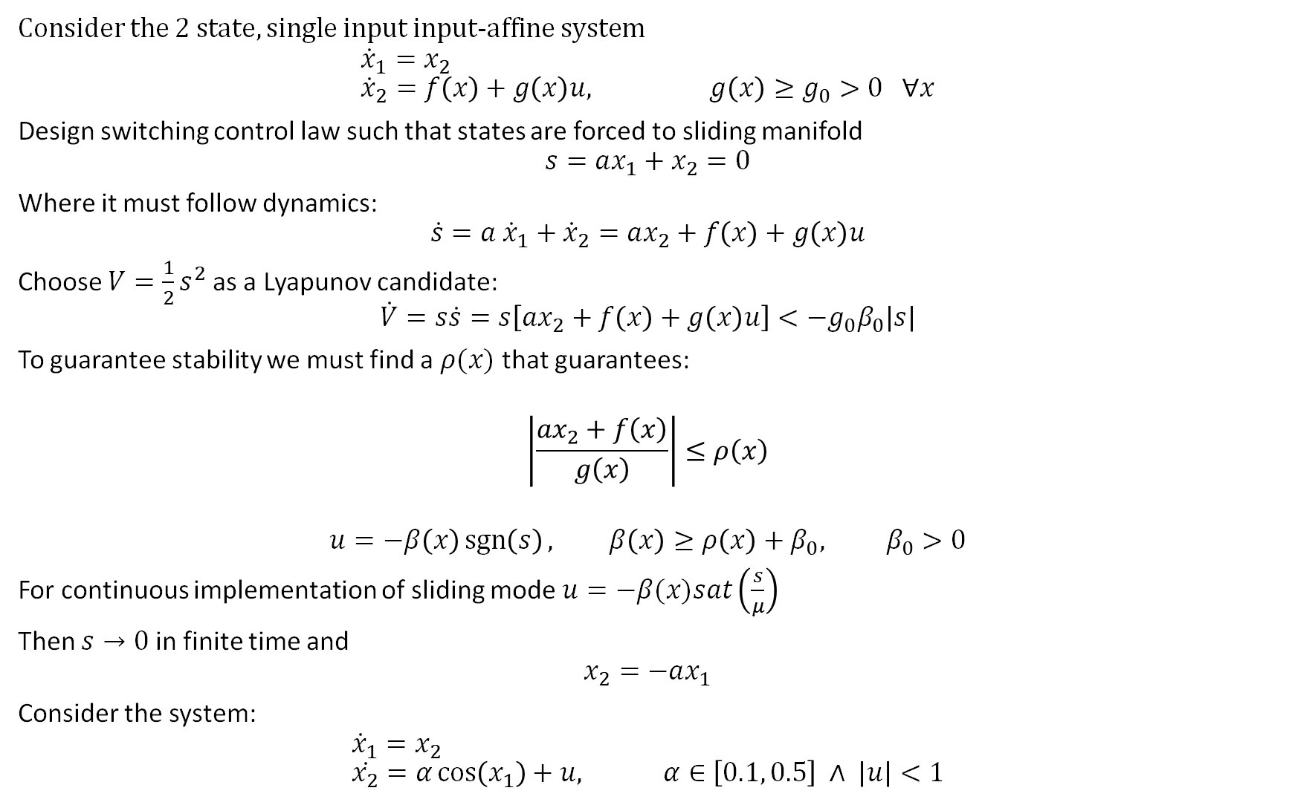
Consider the 2 state, single input input-affine system
$${\dot{x}}_{1}=x_{2} \\ {\dot{x}}_{2}=f\left(x\right)+g\left(x\right)u, g\left(x\right)≥g_{0}>0 ∀x$$
Design switching control law such that states are forced to sliding manifold
$$s=ax_{1}+x_{2}=0$$
Where it must follow dynamics:
$$\dot{s}=a {\dot{x}}_{1}+{\dot{x}}_{2}=ax_{2}+f\left(x\right)+g\left(x\right)u$$
Choose $V=\frac{1}{2}s^{2}$ as a Lyapunov candidate:
$$\dot{V}=s\dot{s}=s\left[ax_{2}+f\left(x\right)+g\left(x\right)u\right]<−g_{0}β_{0}\left|s\right|$$
To guarantee stability we must find a $ρ(x)$ that guarantees:
$$\left|\frac{ax_{2}+f\left(x\right)}{g\left(x\right)}\right|≤ρ\left(x\right)$$
$$u=−β\left(x\right)\operatorname{sgn}\left(s\right), β\left(x\right)≥ρ\left(x\right)+β_{0}, β_{0}>0$$
For continuous implementation of sliding mode $u=−β(x)sat\left(\frac{s}{μ}\right)$
Then $s→0$ in finite time and
$$x_{2}=−ax_{1}$$
Consider the system:
$${\dot{x}}_{1}=x_{2} \\ \dot{x_{2}}=α\cos\left(x_{1}\right)+u, α∈\left[0.1, 0.5\right] ∧ \left|u\right|<1$$

Slide 3
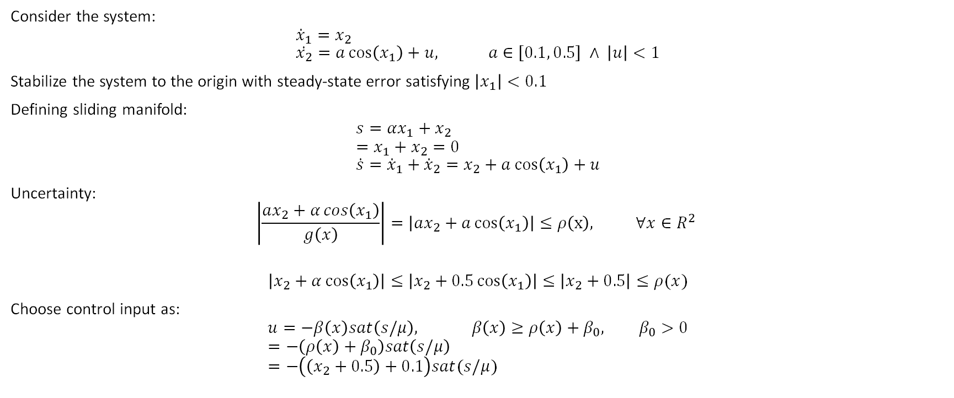
Example 10.6
Consider the system:
$${\dot{x}}_{1}=x_{2} \\ \dot{x_{2}}=a\cos\left(x_{1}\right)+u, a∈\left[0.1, 0.5\right] ∧ \left|u\right|<1$$
Stabilize the system to the origin with steady-state error satisfying $\left|x_{1}\right|<0.1$
Defining sliding manifold:
$$s=αx_{1}+x_{2} \\ =x_{1}+x_{2}=0 \\ \dot{s}={\dot{x}}_{1}+{\dot{x}}_{2}=x_{2}+a\cos\left(x_{1}\right)+u$$
Uncertainty:
$$\left|\frac{ax_{2}+α\cos\left(x_{1}\right)}{g\left(x\right)}\right|=\left|ax_{2}+a\cos\left(x_{1}\right)\right|≤ρ\left(x\right), ∀x∈R^{2}$$
$$\left|x_{2}+α\cos\left(x_{1}\right)\right|≤\left|x_{2}+0.5\cos\left(x_{1}\right)\right|≤\left|x_{2}+0.5\right|≤ρ(x)$$
Choose control input as:
$$u=−β\left(x\right)sat\left(s/μ\right), β\left(x\right)≥ρ\left(x\right)+β_{0}, β_{0}>0 \\ =−\left(ρ\left(x\right)+β_{0}\right)sat\left(s/μ\right) \\ =−\left(\left(x_{2}+0.5\right)+0.1\right)sat(s/μ)$$

Slide 4

Example 10.6
The above control law does not respect $\left|u\right|≤1$
If $β=x_{2}+0.5+β_{0}$ is chosen and a saturation function is used:
$$u=−1 sat\left(\frac{s}{μ}\right)$$

